Slide 1
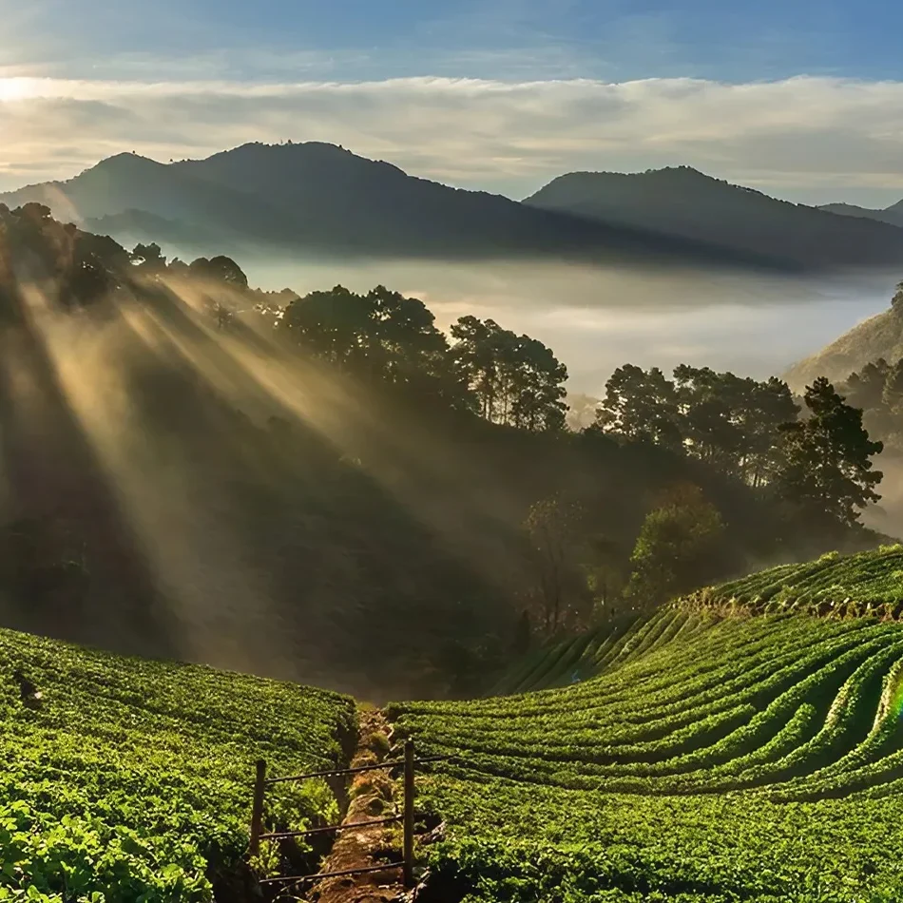
Group Name → The Analyzer
Members Name → Siya Salvi
Kunika Gulve
Akanksha Patel
Batch — T343
Mentor — Prachiti Sonawane
IT Vedant Education PVT LTD

Slide 2
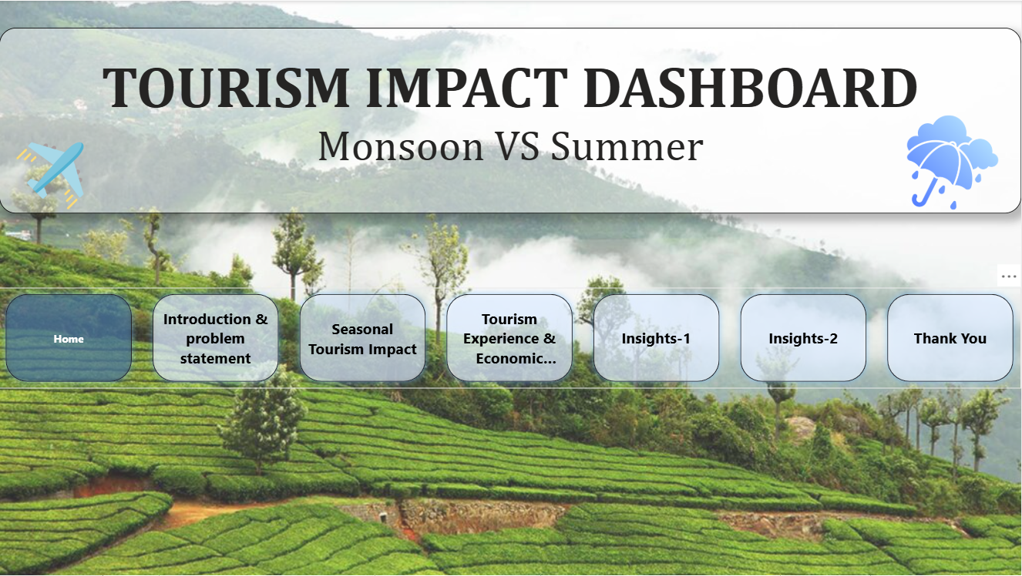

Slide 3
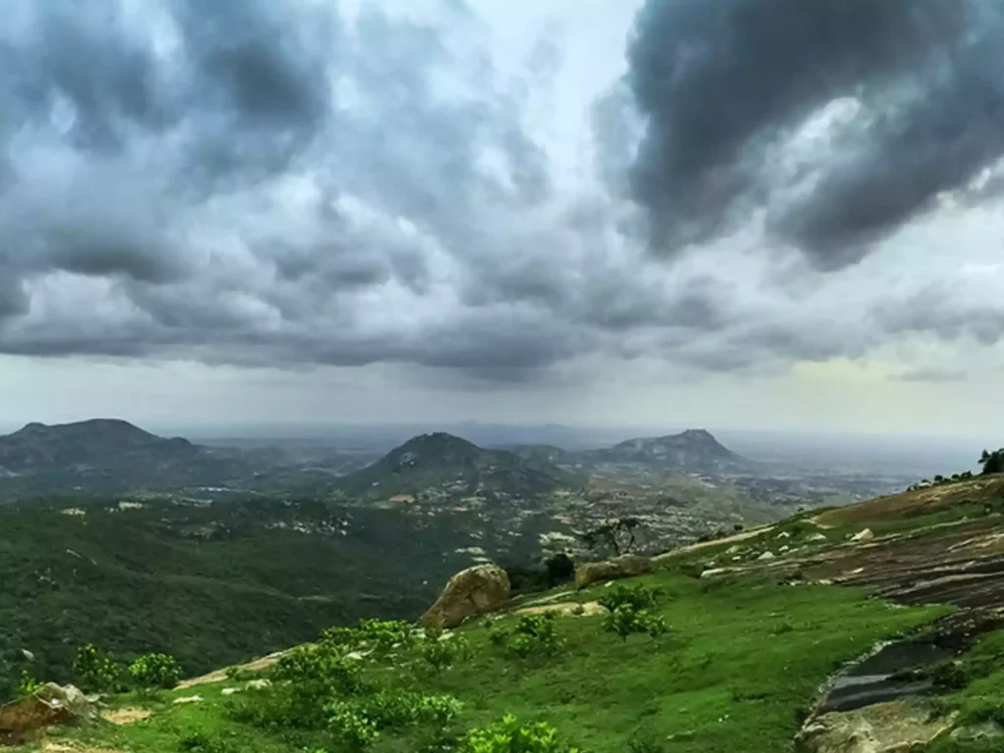
Introduction:
This study analyzes the impact of Monsoon vs. Summer tourism across Indian states and cities. It evaluates tourist demographics, focusing on domestic versus international visitors, and examines key economic and infrastructure factors such as revenue generation, hotel availability, occupancy rates, and eco-tourism activities. The objective is to derive actionable insights that can support seasonal planning and resource allocation in the tourism sector.
Problem Statement:
Tourism impact in India varies significantly between Monsoon and Summer seasons, directly influencing revenue and visitor numbers. However, there is limited visibility into domestic versus international tourist patterns and spending behavior. Additionally, challenges remain in assessing infrastructure utilization, including hotels, eco-tourism initiatives, and transport modes. Therefore, a data-driven approach is required to guide policy decisions and marketing strategies, ensuring sustainable growth and improved tourist experiences.

Slide 4
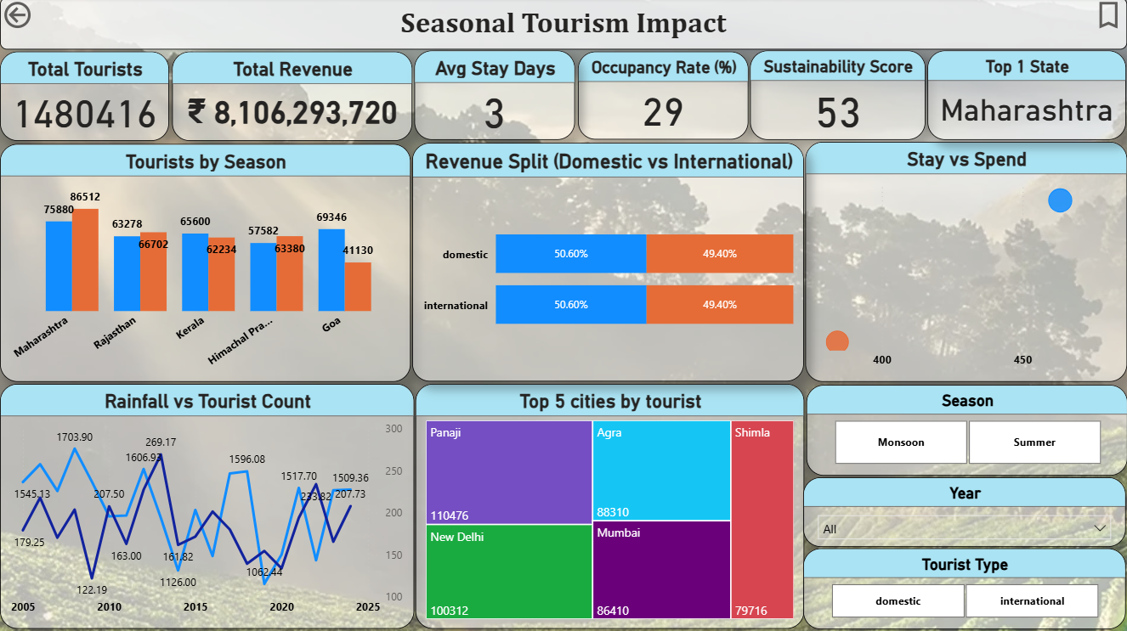

Slide 5
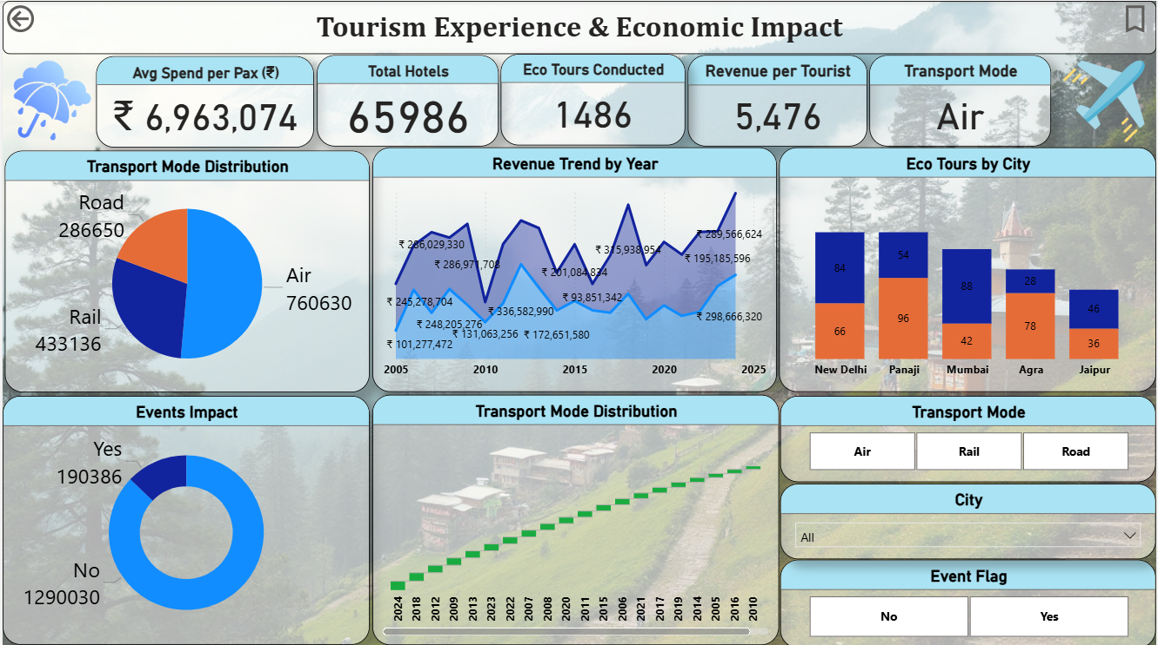

Slide 6
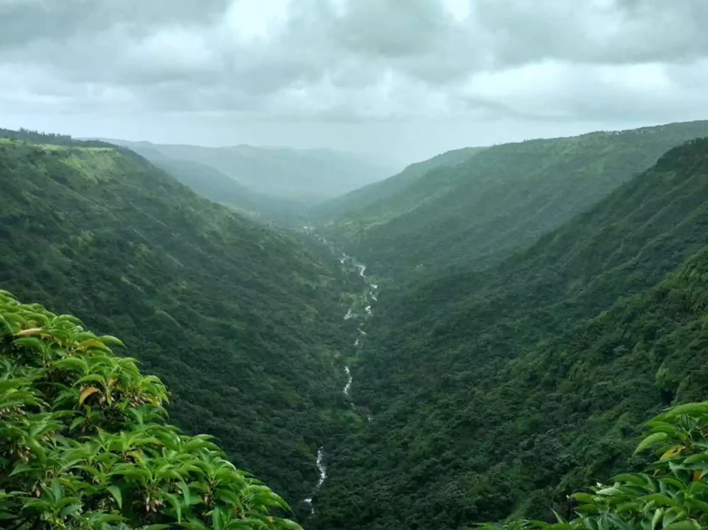
INSIGHTS
Seasonal Tourism Impact:
Tourists by Season– Maharashtra has the highest tourist inflow, while Himachal Pradesh has the lowest among shown states.
Revenue Split– Revenue is almost evenly split between domestic and international tourists.
Stay vs Spend – Higher spending is associated with slightly longer stays.
Rainfall vs Tourist Count– Tourist numbers fluctuate with rainfall, showing seasonal dependency.
Top 5 Cities by Tourist– Panaji records the highest tourist visits, while Shimla has the lowest among the top five.

Slide 7
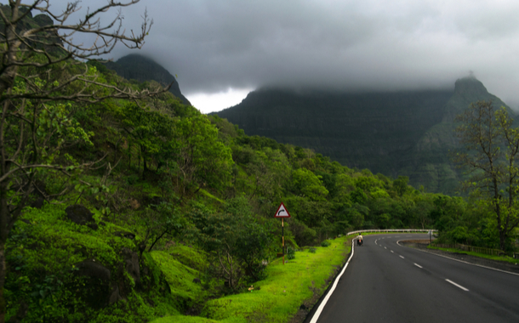
INSIGHTS
Tourism Experience and Economic Impact:
Transport Mode Distribution – Air travel dominates tourism transport, followed by rail and then road.
Revenue Trend by Year– Tourism revenue shows fluctuations but a sharp rise after 2020.
Eco Tours by City– Mumbai leads in eco tours, followed by New Delhi, while Jaipur has the least.
Events Impact– Majority of tourists are unaffected by events, with only a small share showing impact.
Transport Mode Distribution over Time – Transport usage has steadily increased year by year.

Slide 8
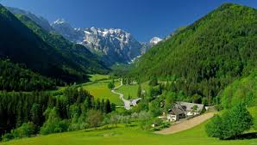
THANK YOU

